Slide 1
Capstone Project -
The Battle of the Neighborhoods
Exploring the city of Toronto

Slide 2
Introduction: Business Problem
In this project we will try to find an optimal location for a restaurant. Specifically, this report will be targeted to stakeholders interested in opening an restaurant in Toronto, Canada.
Here we will try finding if someone wants to open a new restaurant in the city which location is best suited for it keeping in mind the competitors and which income group of people will be attracted most to it based on the population of the neighbourhood.
Since there are lots of restaurants in Toronto, we will try to detect locations that are not already crowded with restaurants. We would also prefer locations as close to city center as possible, assuming that first two conditions are met.
We will use our data science powers to generate a few most promissing neighborhoods based on this criteria. Advantages of each area will then be clearly expressed so that best possible final location can be chosen by stakeholders.

Slide 3
Data acquisition and cleaning
Based on definition of our problem, factors that will influence our decission are:
All existing restaurants in the neighborhood (any type of restaurant)
Age group of people with their income
Distance of neighborhood from city center
We decided to use regularly spaced grid of locations, centered around city center, to define our neighborhoods.
Following data sources will be needed to extract/generate the required information:
centers of candidate areas will be generated algorithmically and approximate addresses of centers of those areas will be obtained using https://en.wikipedia.org/wiki/List_of_postal_codes_of_Canada:_M
number of restaurants and their type and location in every neighborhood will be obtained using Foursquare API

Slide 4
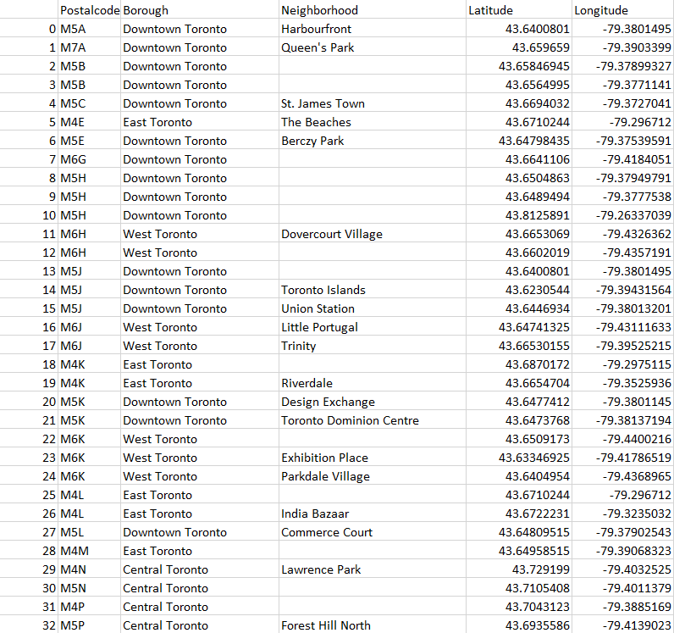

Slide 5
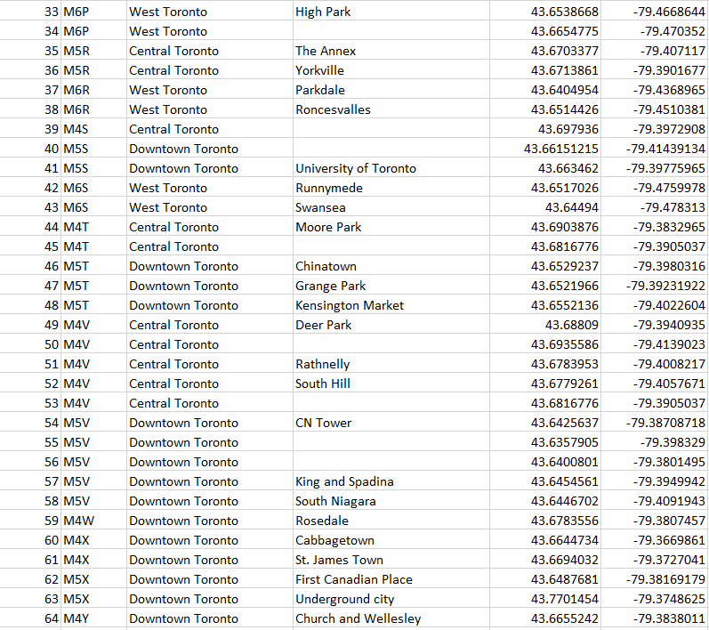

Slide 6
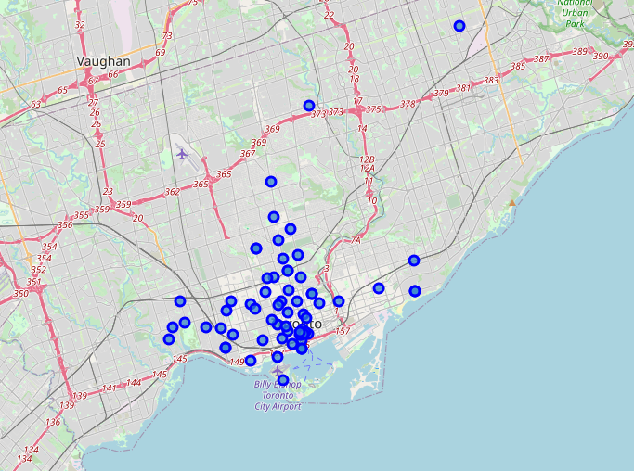
Map of Toronto

Slide 7
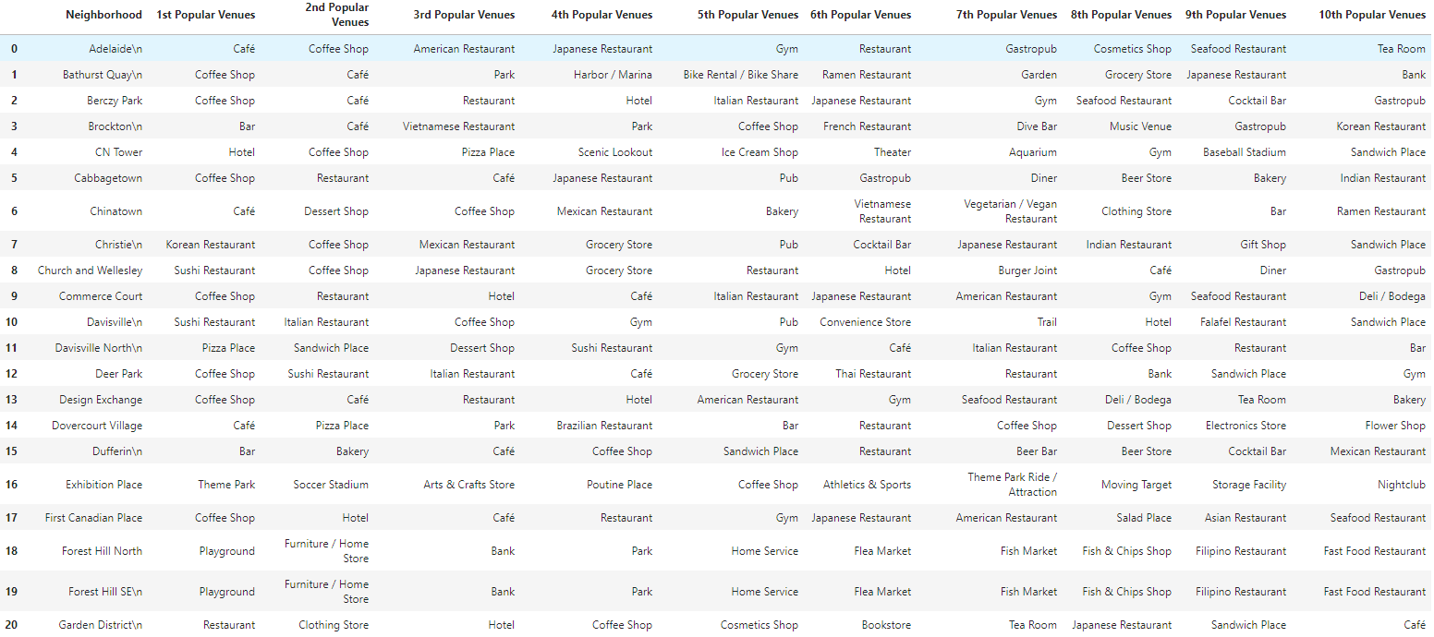
Neighborhoods in Toronto with their nearby
10 most Popular Venues

Slide 8
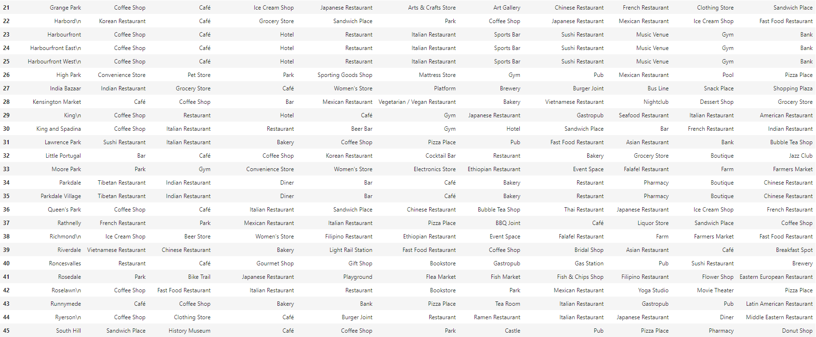

Slide 9
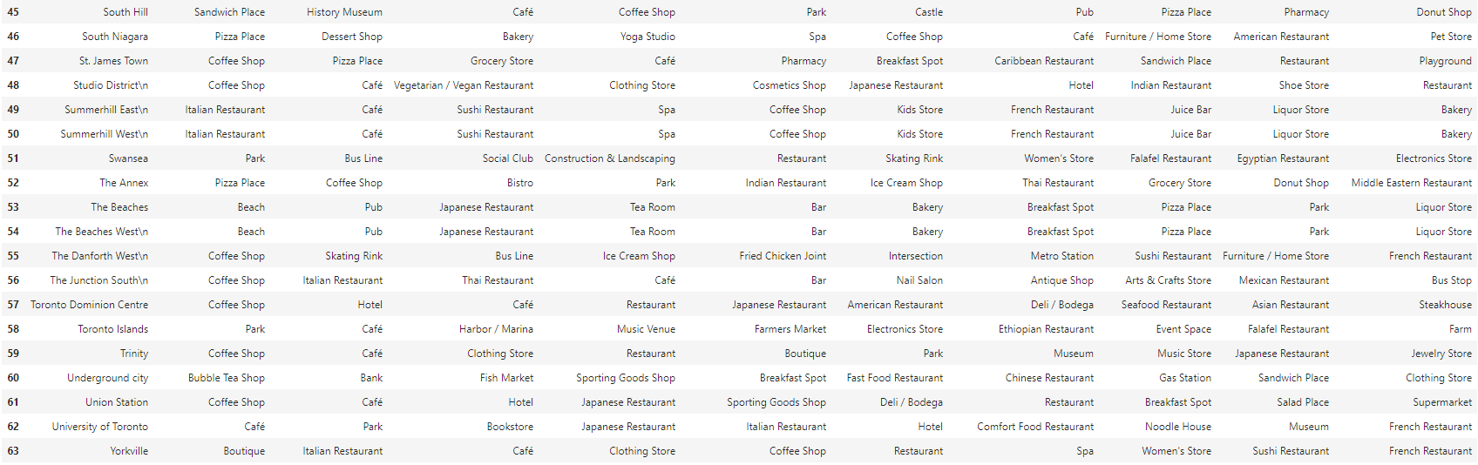

Slide 10
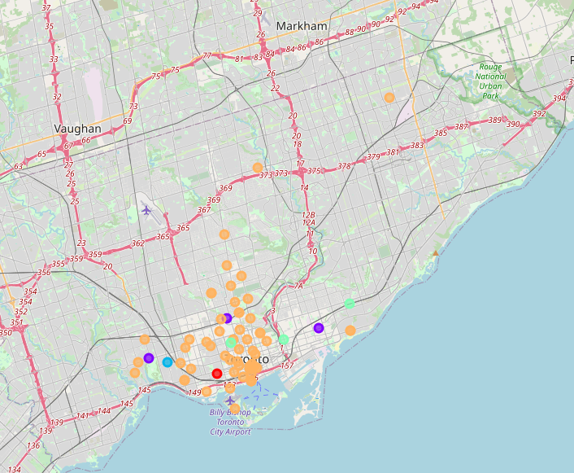
Map Showing the 5 k-mean clusters

Slide 11
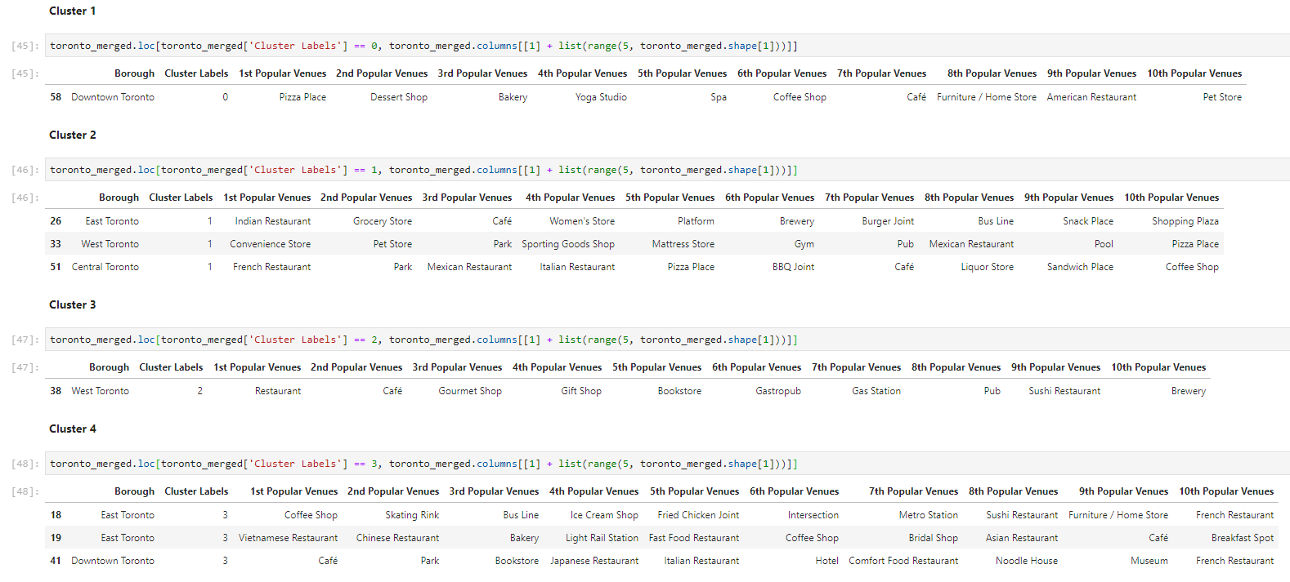

Slide 12
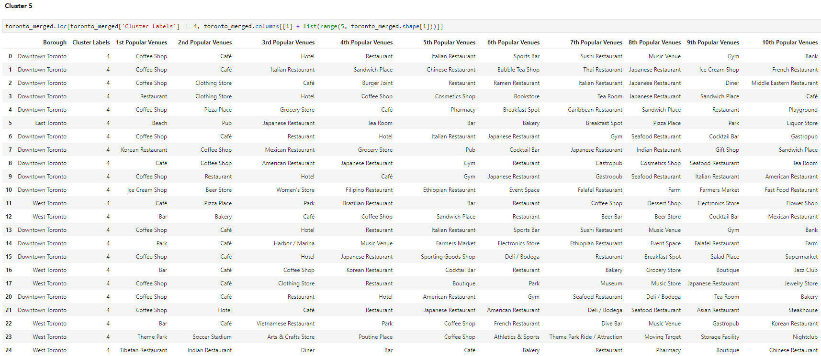

Slide 13
Conclusion
Purpose of this project was to identify areas n Toronto with low number of restaurants in order to aid stakeholders in narrowing down the search for optimal location for a new restaurant. By calculating restaurant density distribution from Foursquare data we have first identified general boroughs that justify further analysis, and then generated extensive collection of locations which satisfy some basic requirements regarding existing nearby restaurants. Clustering of those locations was then performed in order to create major zones of interest (containing greatest number of potential locations) and addresses of those zone centers were created to be used as starting points for final exploration by stakeholders.
Final decision on optimal restaurant location will be made by stakeholders based on specific characteristics of neighborhoods and locations in every recommended zone, taking into consideration additional factors like attractiveness of each location (proximity to park or water), levels of noise / proximity to major roads, real estate availability, prices, social and economic dynamics of every neighborhood etc.

